Slide 1
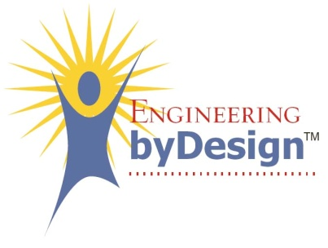
Orthographic Projection Drawings
FOT
Student Resource

Slide 2
Orthographic Projection Drawings
An orthographic projection drawing is the type of drawing most commonly used in the production of parts or items.
It shows multiple views of a object with detailed dimensions and information in each view.

Slide 3
Most Common
Drawing
Top
Front
Right

Slide 4
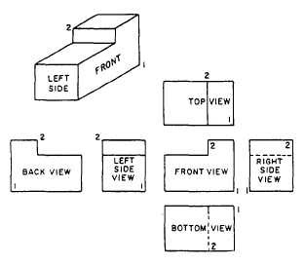
Views as Required
Normally the number of views that are needed depends on the complexity of the item and how many views are needed to fully describe the object.

Slide 5
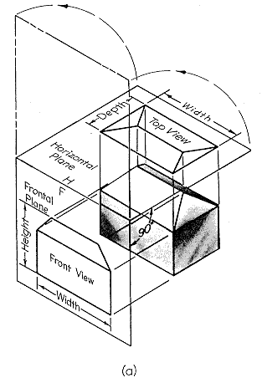
Which View is
the Front?
The front view will typically be the side of the object that contains the most information, meaning the most complex.
If it’s not clear, use the largest side as the front side.

Slide 6
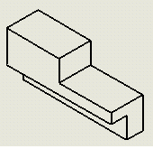
Deciding Other
Views
Generally when you do an orthographic projection drawing you already have an isometric, sketch, or 3d prototype to base it on.

Slide 7
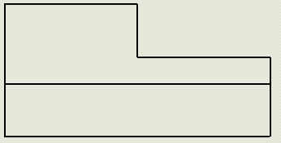
First Steps
The first step in making an orthographic projection drawing is to identify the front view.
Next you draw the front view in the bottom left.
2.5”
1”
2.5” tall
½ “
1”
5 inches wide

Slide 8
Adding the Top View
Use light construction lines
Each part of the front view must be projected onto the top view.
The next slide will show the top view

Slide 9
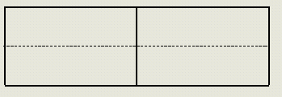
Showing Details
The hidden line is shown in the top view down the middle.
After adding the right side view the object will become fully defined.
5”
1.5”

Slide 10
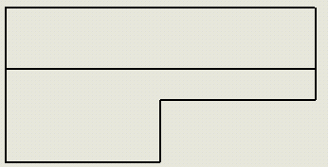
Drawing the Side View
Draw a line extending from the top right corner of the front view at 45 degrees.
Draw all horizontal projections from each view.
Make vertical projections from the points where the projections intersect the 45 degree line.

Slide 11
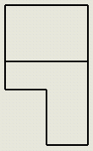
Finishing Up
Now with all 3 views we can tell exactly what the object looks like.
Views can also be dimensioned very clearly and are drawn in true length.
1.5”
2.5”

Slide 12
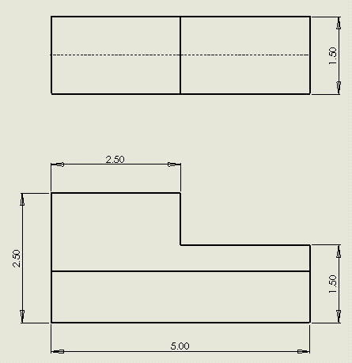
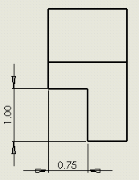
Dimensioning
With dimensions added we get our final product ready for production.

