Slide 1
Web design
Tools and considerations

Slide 2
usability
Easy to find what you’re looking for?
https://www.orbitmedia.com/blog/web-design-standards/

Slide 3
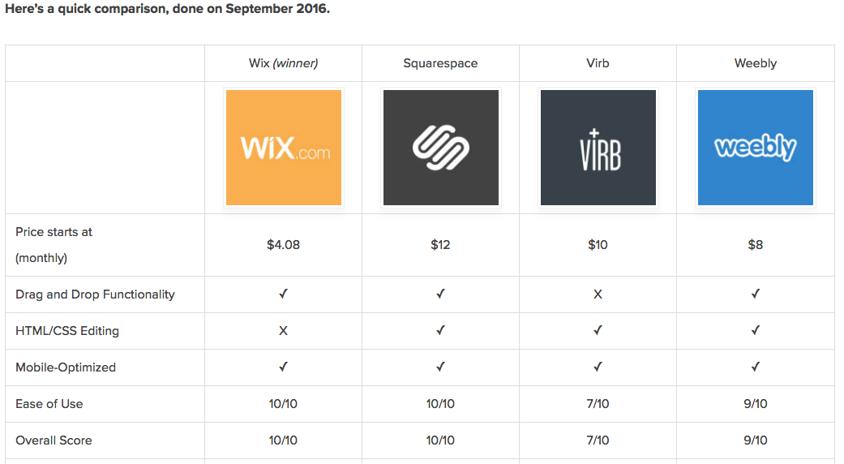
Best design tools
https://www.designbombs.com/website-builder-showdown-wix-vs-squarespace-vs-virb-vs-weebly/

Slide 4
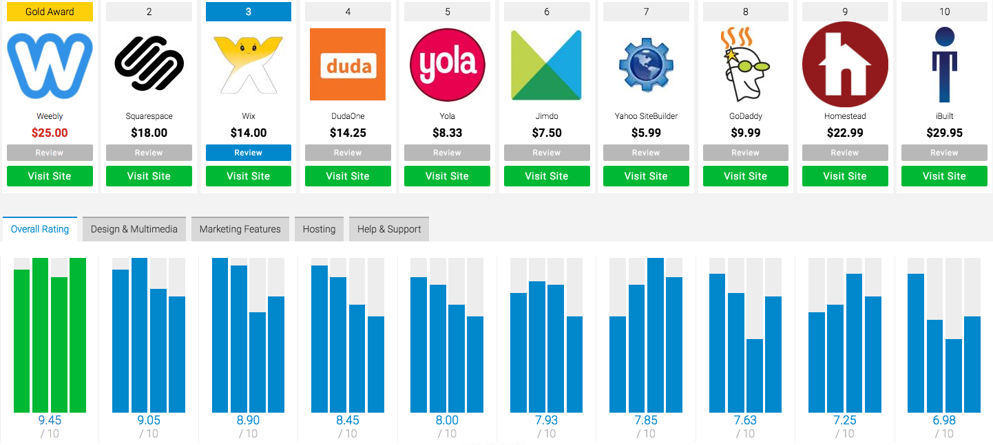
Another opinion
http://www.toptenreviews.com/business/internet/best-web-design-software/

Slide 5
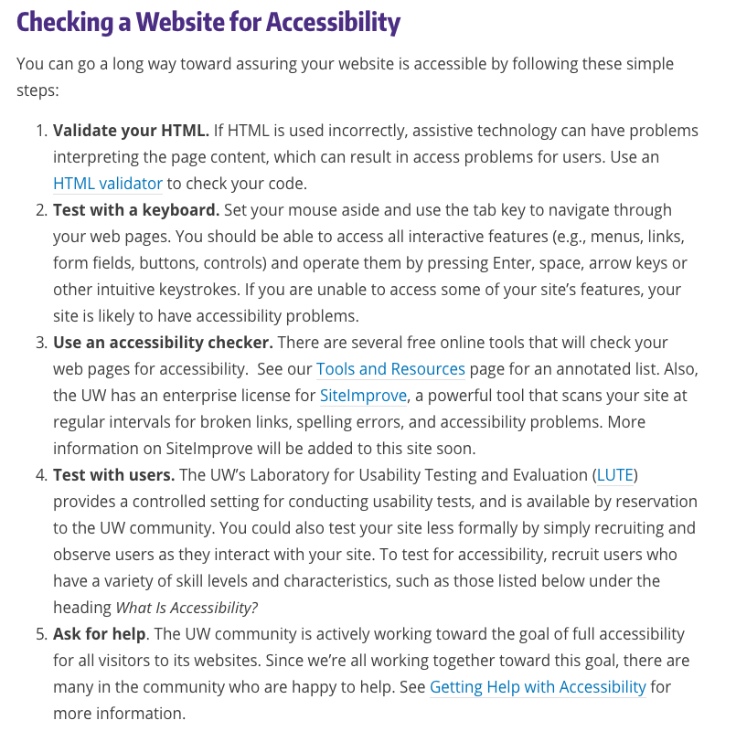
accessibility
Color contrast
Text size
Accommodations for mobility or vision impaired

