Slide 1
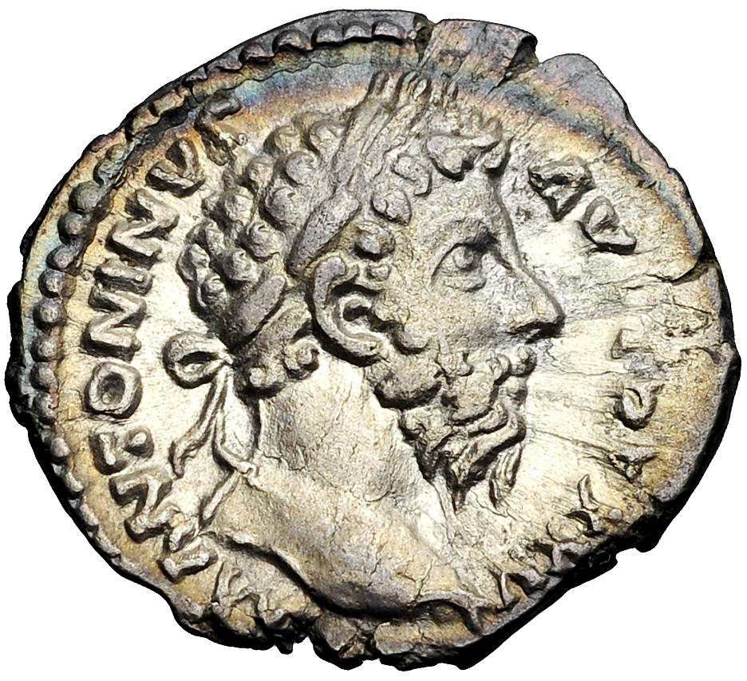
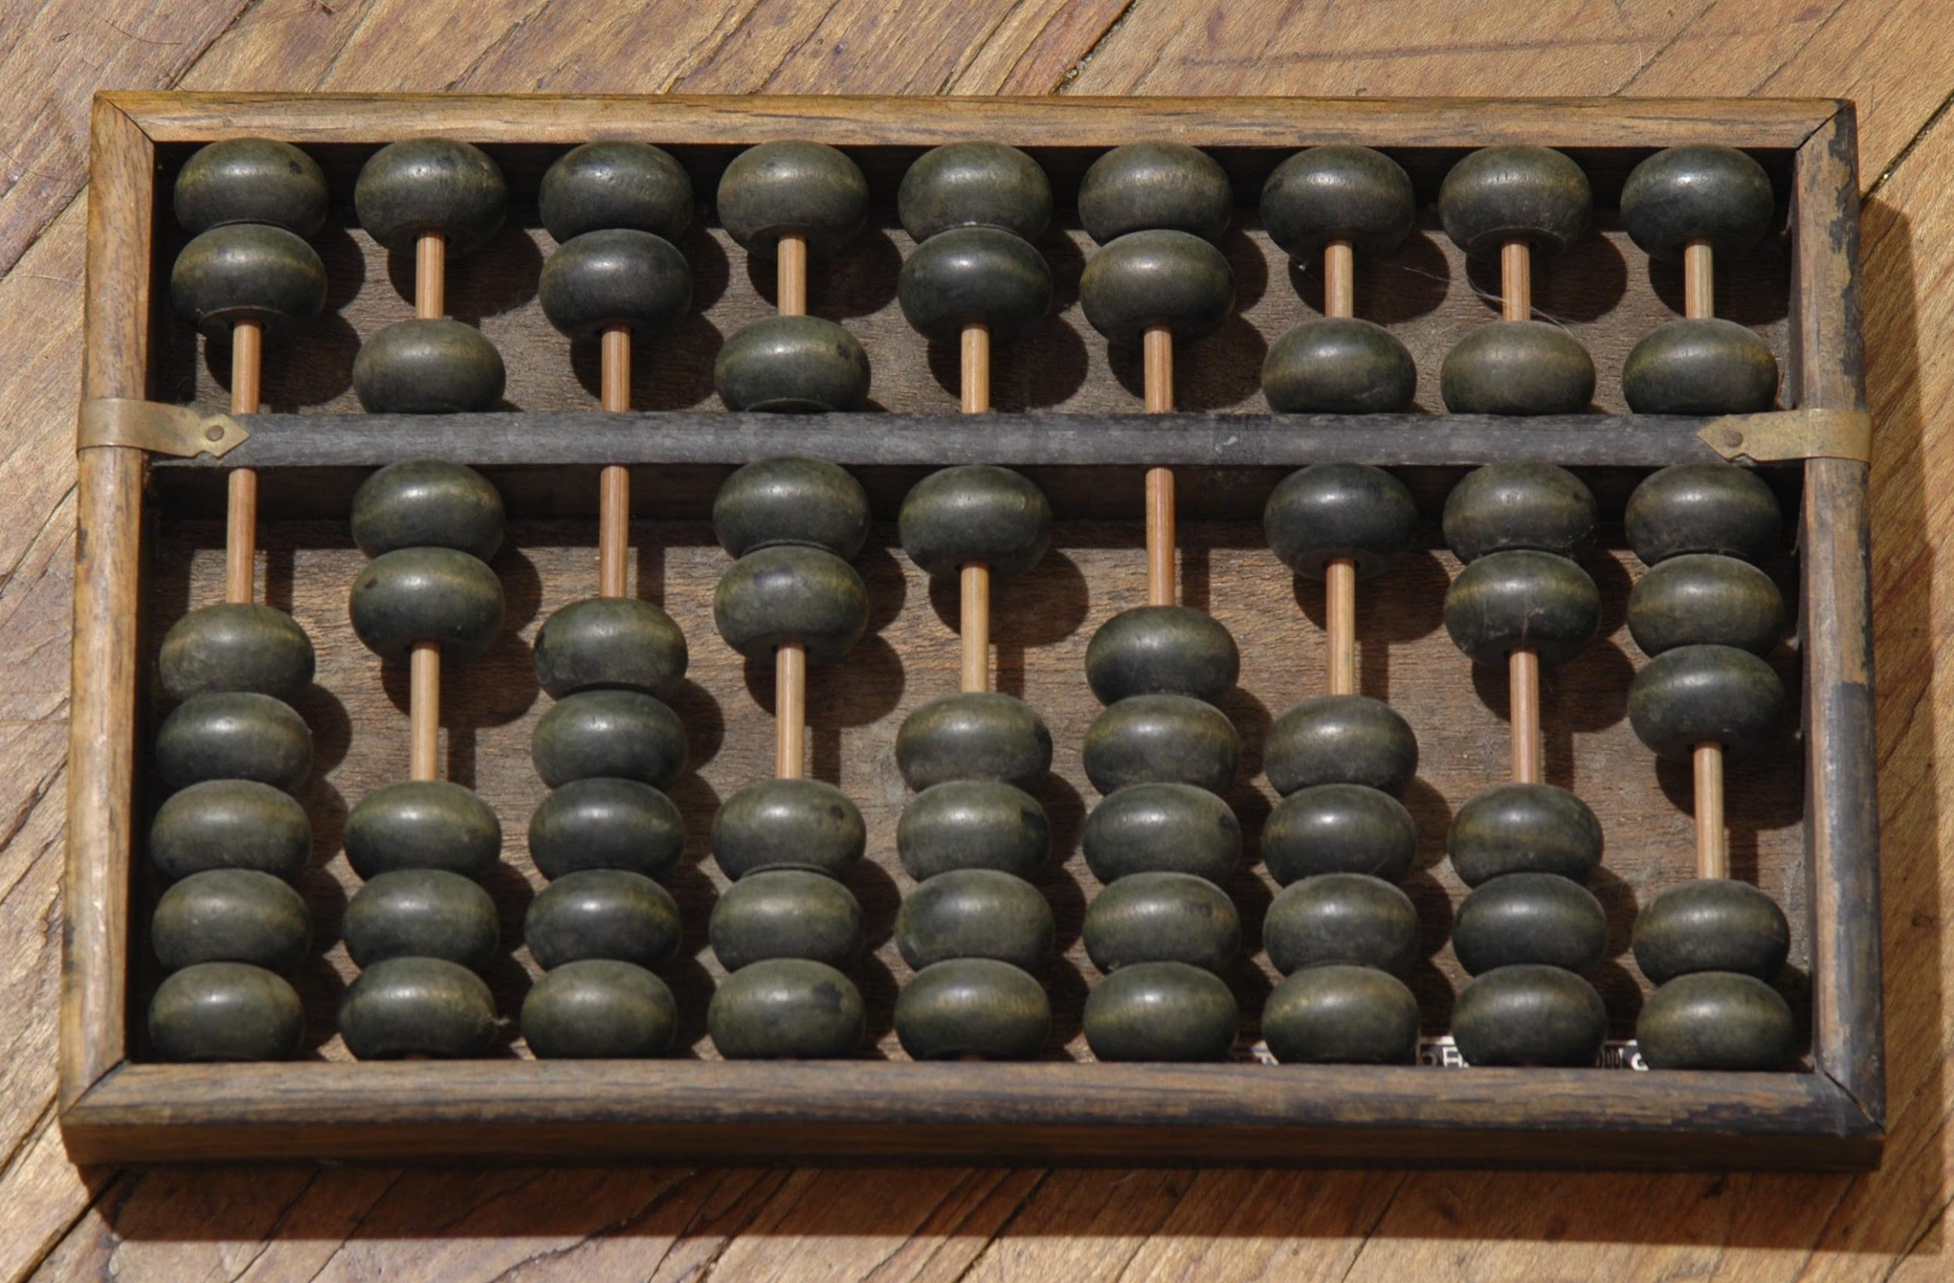
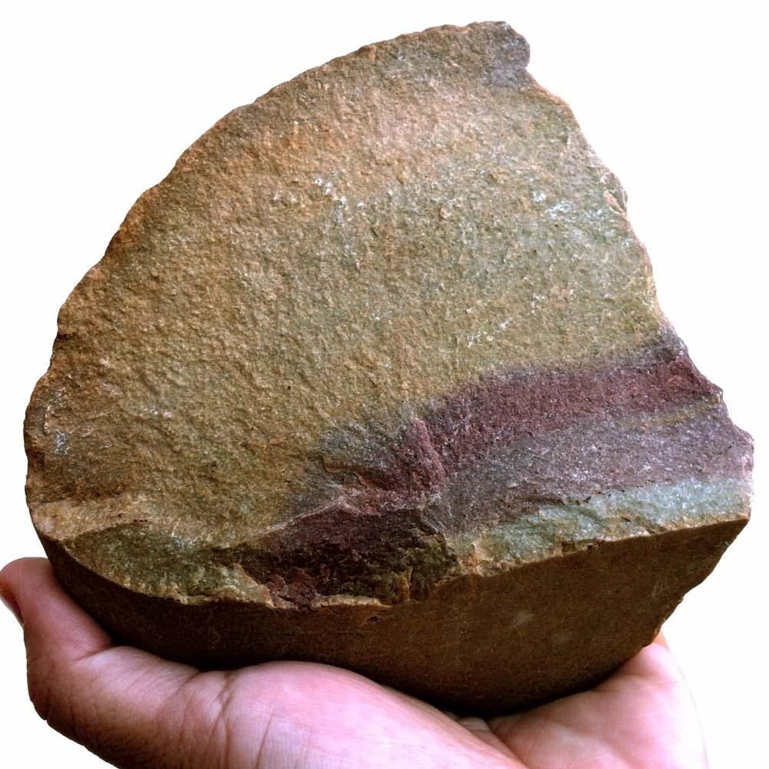
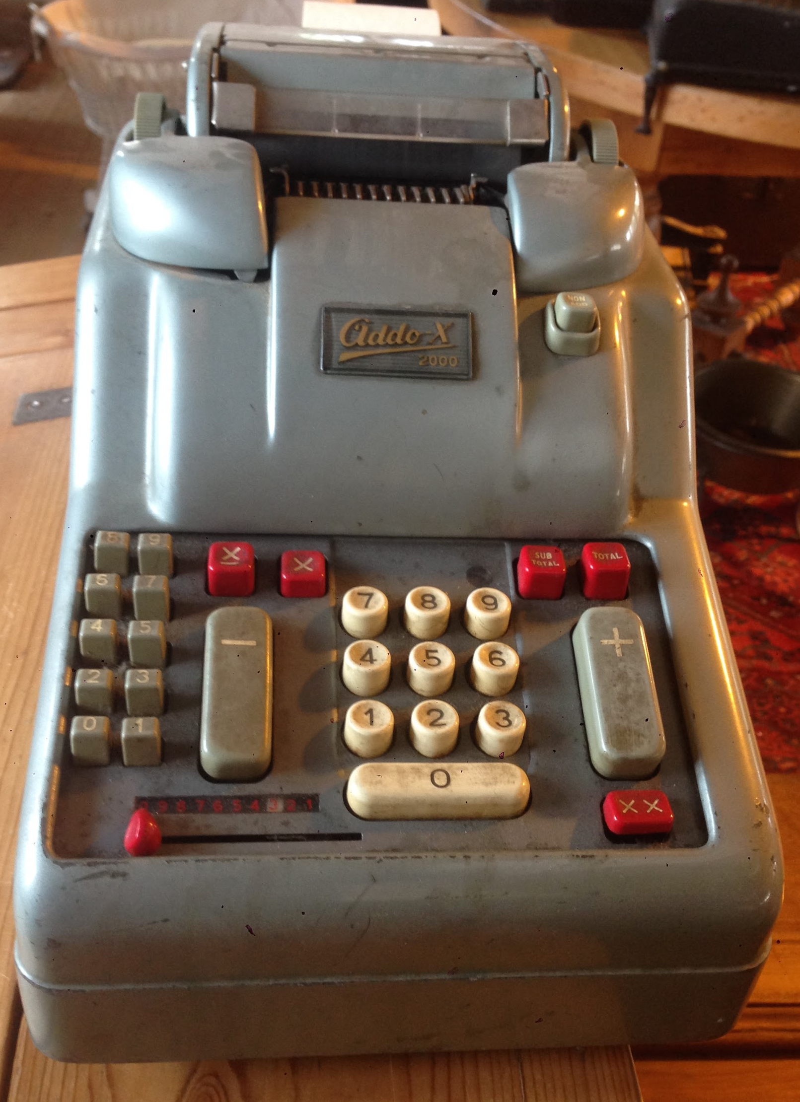
Technology
https://en.wikipedia.org/wiki/Roman_currency
https://en.wikipedia.org/wiki/Suanpan
Where has it been and where is it going?
https://simple.wikipedia.org/wiki/Palaeolithic
https://commons.wikimedia.org/wiki/File:Old_Calculator_1.jpg

Slide 2
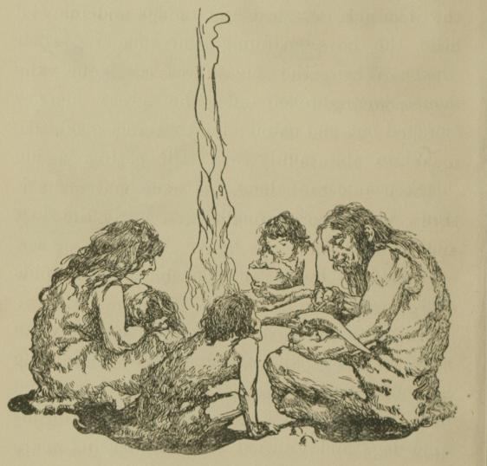
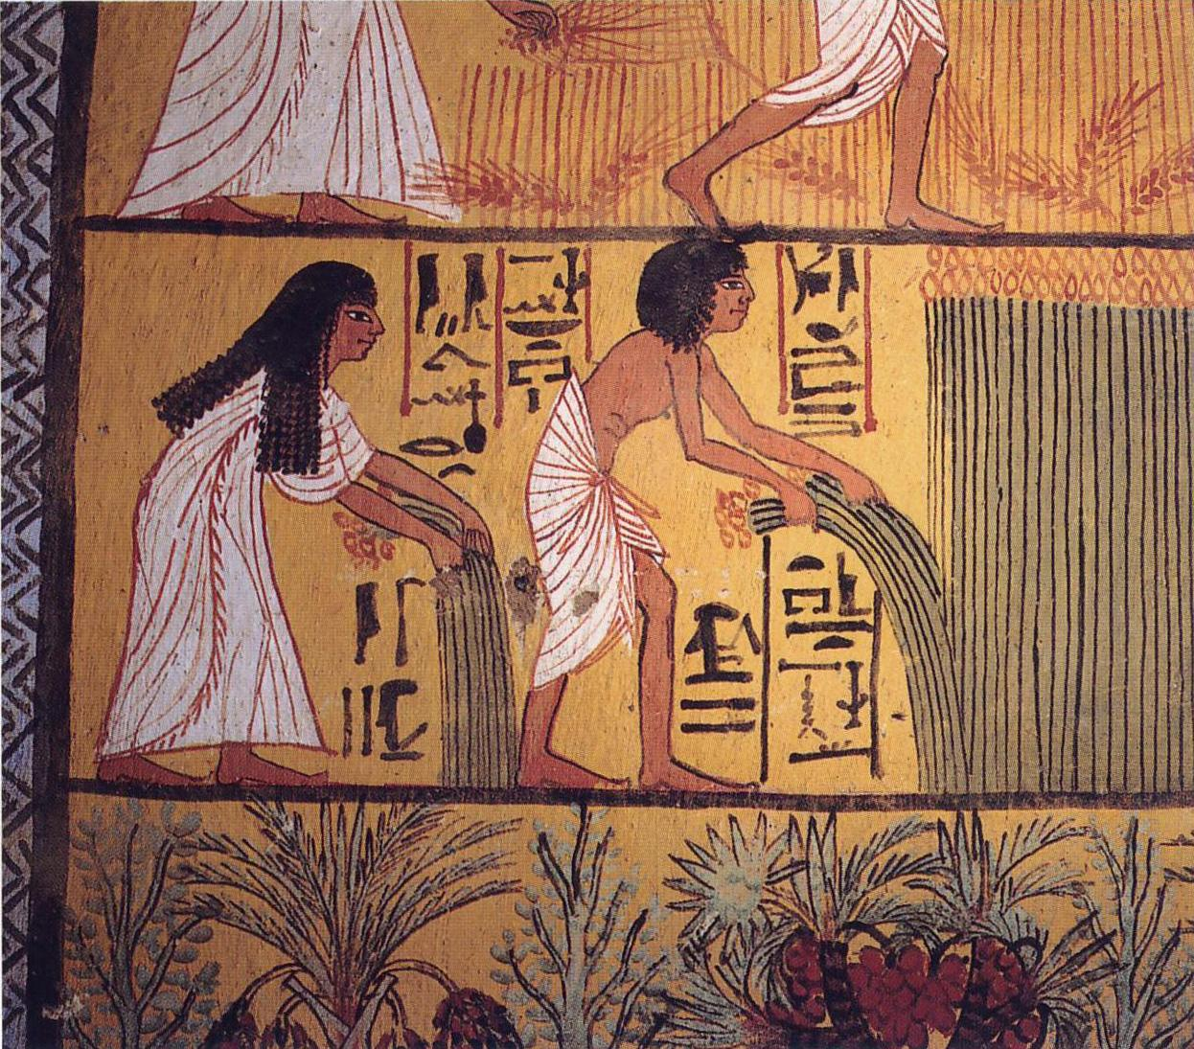
Thousands of years ago
How was life different?
https://en.wikipedia.org/wiki/The_Cave_Boy_of_the_Age_of_Stone
https://en.wikipedia.org/wiki/Ancient_Egyptian_cuisine

Slide 3
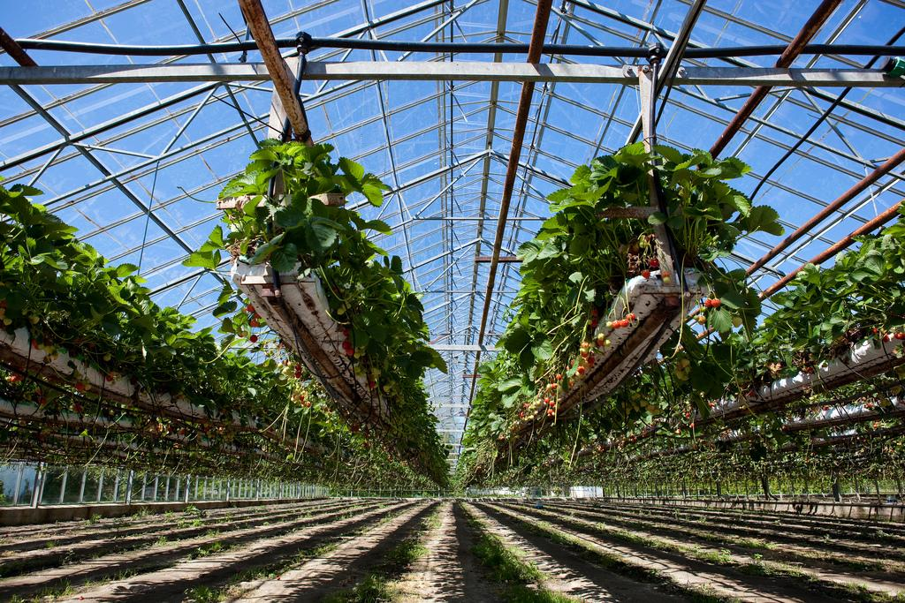
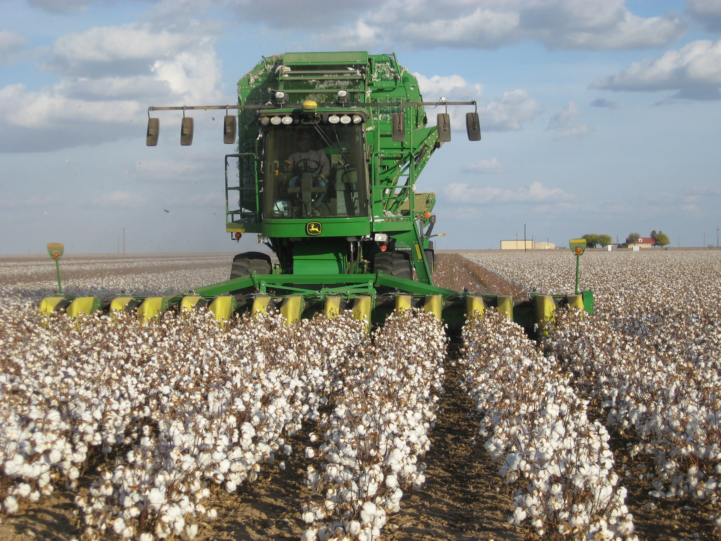
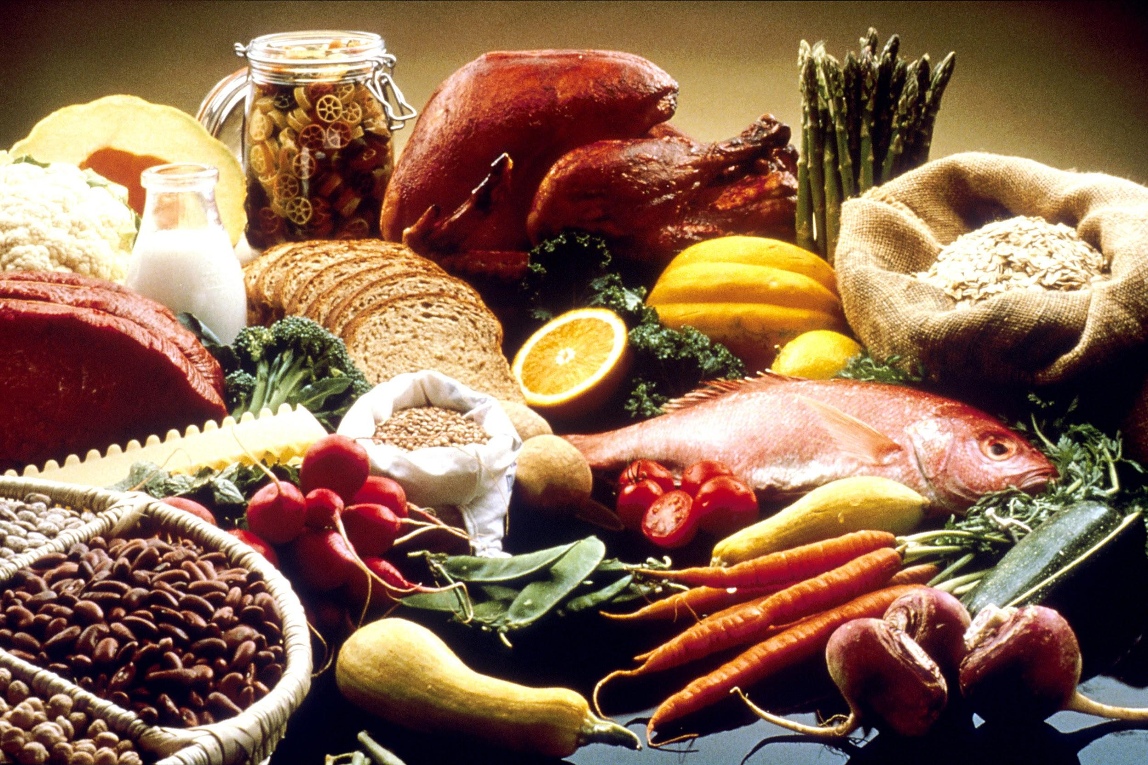
Some specific examples
Food
We buy food in stores. We seldom hunt or gather or grow our own food.
Farms use many different kinds of automated machinery
We have:
greenhouses, hydroponic and rooftop gardening
fast food restaurants
freezers, stoves, refrigerators and plastic wrap
pesticides and artificial fertilizers
bio-engineered GMO foods
https://www.flickr.com/photos/criminalintent/3676036691
https://en.wikipedia.org/wiki/Agricultural_machinery
https://en.wikipedia.org/wiki/Food

Slide 4
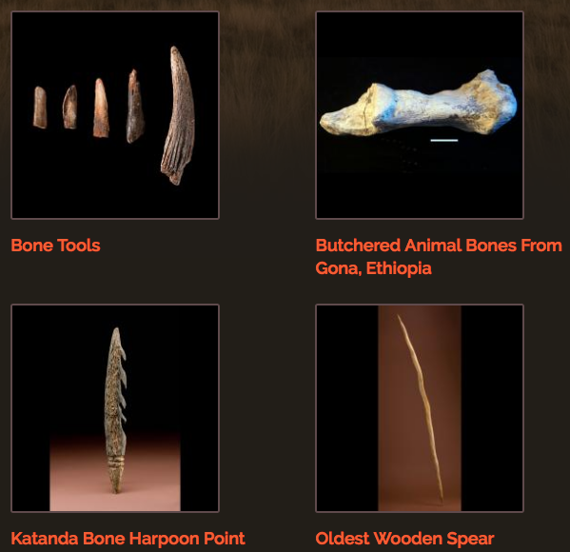
What is different now?
List at least 5 specific things:
Clothing/ Shelter
Transportation
Communication
Medicine
Education
….
http://humanorigins.si.edu/evidence/behavior/stone-tools/early-stone-age-tools

Slide 5
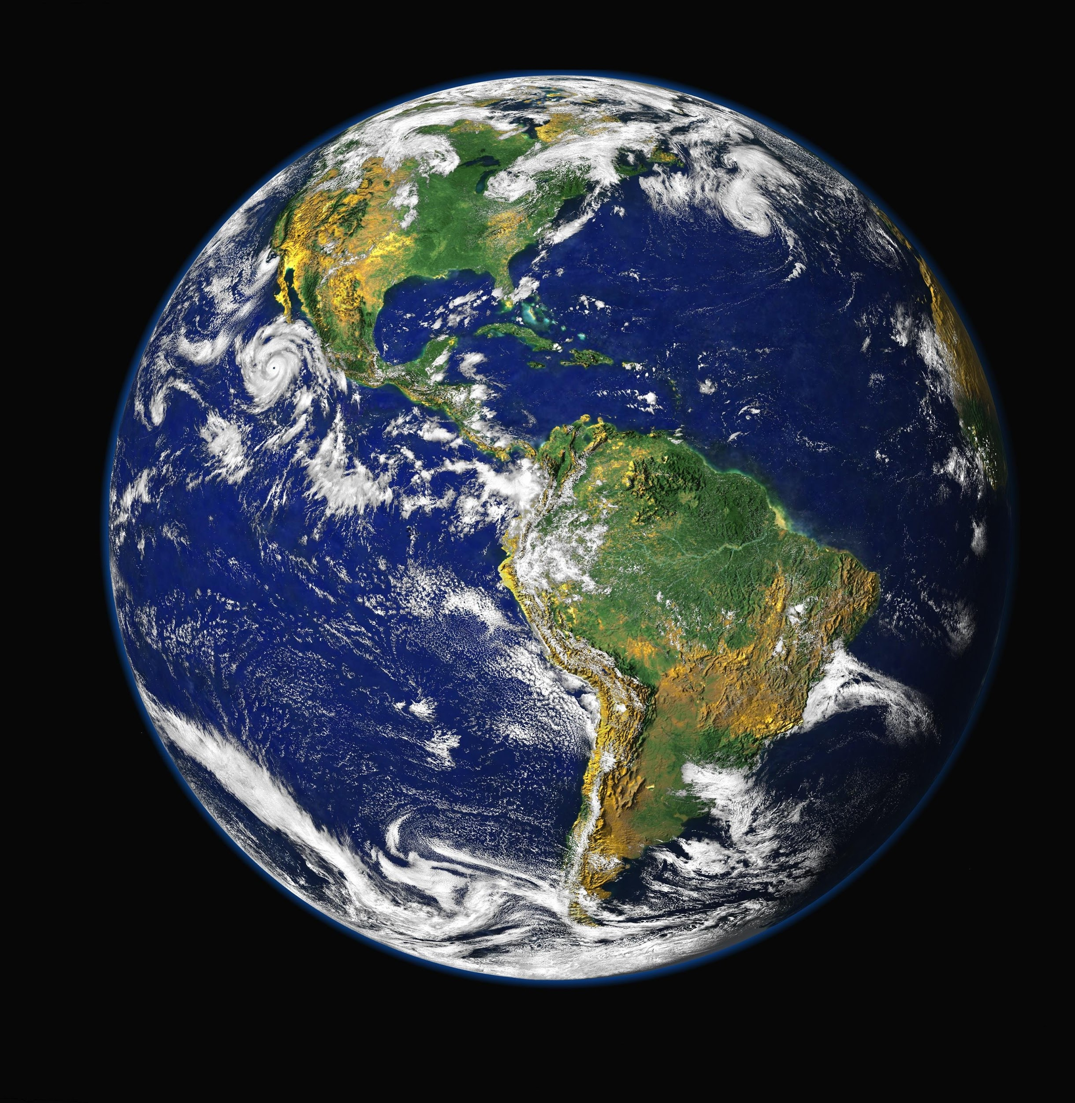
Technology is changing the world.
What is technology?
In your own words.
https://www.pexels.com/search/one%20world%20trade%20center/

Slide 6
What is technology?
(This is just one possible definition, how does it compare to yours?)
Tech·nol·o·gy
tekˈnäləjē/
noun
the application of scientific knowledge for practical purposes, especially in industry.
"advances in computer technology"
machinery and equipment developed from the application of scientific knowledge.
the branch of knowledge dealing with engineering or applied sciences

Slide 7
What is modern technology?
Think of 4 examples of modern technology as a group:
Think of 4 additional examples of modern technology on your own, be sure they are different from anybody else in your group.
Share with the class.
Add 8 more examples of modern technology from others in the class.

Slide 8
Which do you think are the most important?
Which examples of technology make the most difference in the world?
Put a star next to the 5 you think are the most significant
Why do you think each of the starred technologies is important?

Slide 9
As a group, categorize the technology examples.
On the back:
Divide the page up into at least 4 areas.
Arrange the examples of technology into categories.
Write a short explanation of why you selected the categories you chose.

