Slide 1
Design
Refining a design

Slide 2
Models and Testing
Engineers are trained to design small-scale models and then test them to make them better.
Usually they do this over and over again in order to achieve designs that perform as desired.
One important part of this process is keeping track of each design change and its effect on the airplane's performance.
Does the airplane go farther when one part of the wings is changed?
Or does it fly farther when one part of the tail is modified without the wing modification?

Slide 3
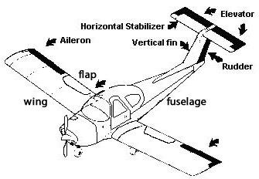
Airplane control surfaces
Label the plane & describe what each part does
aileron: The outward movable section the wing that is used to make a turn. Ailerons move in opposite directions (one up, one down).
cockpit: The space in an airplane fuselage for the pilot and the passengers.
elevator: The movable horizontal section of the tail that causes the nose of the plane to move up and down.
flap: A movable section of the wing closest to the fuselage. Flaps are moved in the same direction (down) to add lift so the airplane can fly more slowly while still creating enough lift to stay in the air.
fuselage: The central body portion of an airplane for the crew and passengers or cargo.
horizontal stabilizer: The horizontal surface attached to the aft part of the fuselage that is used to balance the airplane.
rudder: The movable vertical section of the tail that controls side to side movement.
wing: An airplane part that provides lift and supports most (if not all) of the aircraft weight while in flight.

Slide 4
Stall Nose Dive
Nose up too high, plane no longer flies plane pointed straight down

Slide 5
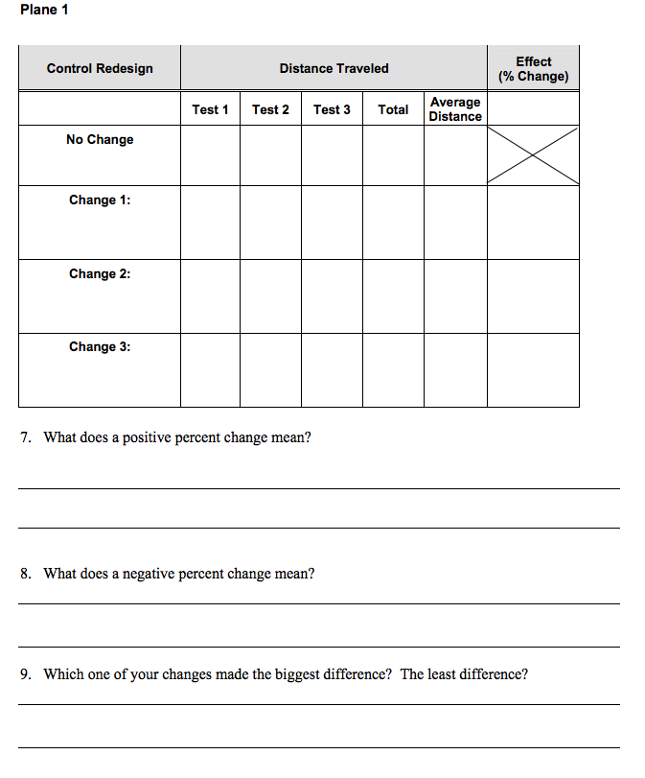
Systematically test and record results
A positive percent change is an improvement in distance
A negative percent change is when the distance is shorter because of the change.

