Slide 1
Flight pt2
It’s all about air
Lift pulls upward
Resistance slows things down Thrust pushes forward
Gravity pulls down

Slide 2
Recap: True or False:
Air pressure is caused by the rotation of the Earth.
The faster air moves, the higher the pressure.
Air pressure pushes in all directions.
Notes:
True or False: Air pressure is caused by the rotation of the Earth. (Answer: False. Air pressure is caused by gravity pulling air towards the Earth.)
True or False: The faster air moves, the higher the pressure. (Answer: False. Pressure decreases as air velocity increases.)
True of False: Air pressure pushes in all directions. (Answer: True. Air pressure not only pushes down on us, but it also pushes from the sides and even from below.)

Slide 3
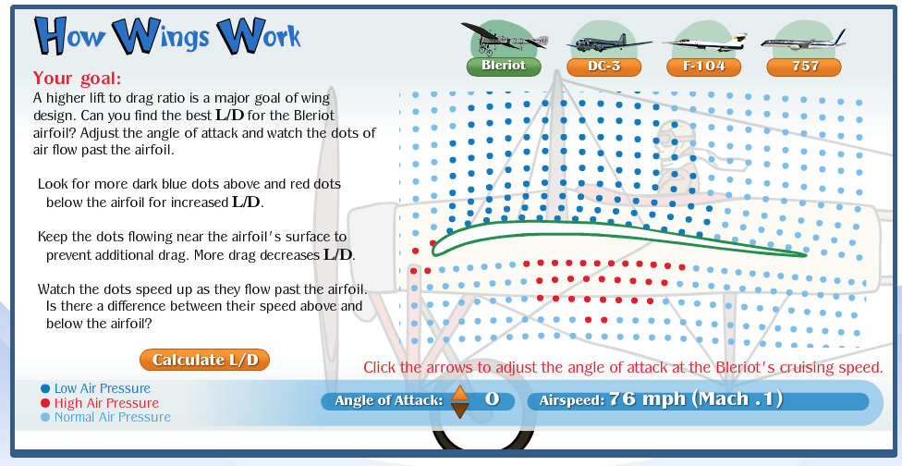
Recap: Last class What does it take to make something fly?
There must be more _____ than _______
There must be more _____ than _______
http://howthingsfly.si.edu/activities/forces-flight
Design a high flying plane and find the best angle for an efficient wing.
http://howthingsfly.si.edu/activities/how-wings-work

Slide 4
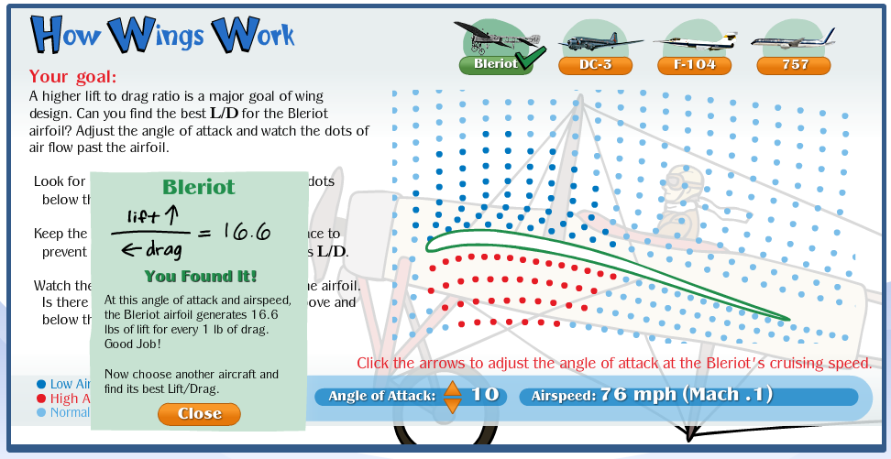
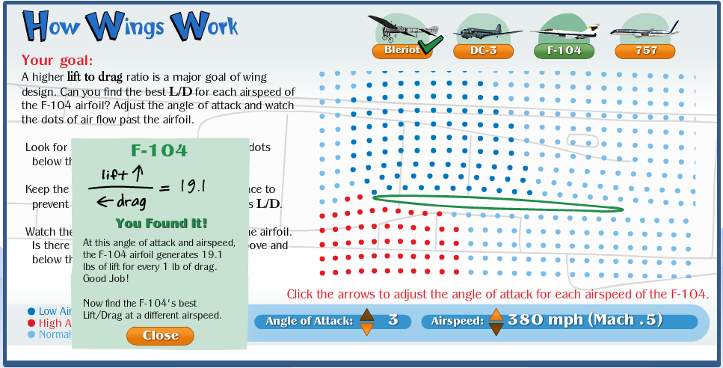
Review
At low speeds you need more curve and angle of attack to get a good L/D (lift to drag) ratio.
At high speeds a very small angle of attack with a small change in curvature produces a good L/D ratio.

Slide 5
If you arm wrestle someone---who wins?
Well of course, the person who exerts the most force wins! But, if both "wrestlers" push with the same force, their arms do not move.
Lift on airplane wings is somewhat similar. As air flows over the top and bottom of the wing the pressure and velocity of the air change. These changes create lift. But on a symmetric wing, the changes on the top half match the bottom half. If the forces on the top and bottom of the wing are the same, no lift results. Because a cambered airfoil (the curve in the wing) is not symmetric, the forces on the top and bottom are different—in this case, lift is generated.

Slide 6
Can you ever have lift on a symmetric airfoil?
Yes, if you raised the nose of the airplane. Doing this places the wing at an angle. Engineers call this the angle of attack. Now the forces on the top and bottom of the wing are different, and create lift.
The greater the angle of attack, the more lift; however, this only works up to a certain angle. If the angle is too high, the air will not flow smoothly over the airfoil and no lift can be created; in this case, the wing stalls, which means it loses lift.

Slide 7
Wind tunnels
Engineers often use wind tunnels to see how the air is flowing and if it flows smoothly over a wing. They do this by filling a wind tunnel's air chamber with smoke and watching as the (smoky) air blows over a model wing. This process also helps them determine how much drag an airfoil has by the size of the wake (an area where the airflow is not smooth at the trailing edge of the airfoil). They can also observe stall when the air has separated from the wing and starts to flow towards the front of the airfoil.
Now try out a virtual wind tunnel yourself!
https://wright.nasa.gov/airplane/tunnl2int.html
http://wayback.archive.org/web/20120524022956/http://www.swe.org/iac/LP/wind_tunnel.html

Slide 8
Wind Tunnel Experiment
Can you change the resistance of a ping pong ball so that it won’t blow away?
Brainstorm: sketch at least 2 possible ideas
Choose the best idea and explain why
Build your idea
Test it.
Redesign.
Test again.
Criteria | Constraints
You must use all materials provided. The ball should move as little as possible Do 2 test runs with modifications in between | You cannot puncture or change the shape of the ball. You cannot stick anything to the ground. You can only use provided materials, nothing extra.

