Slide 1
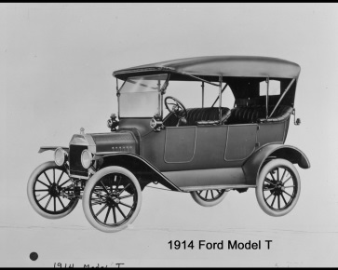
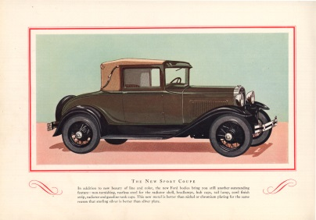
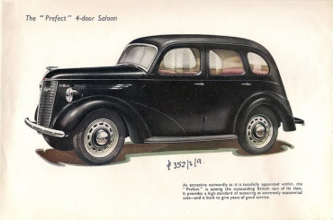
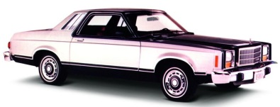
The Renaissance of American Manufacturing
1900
1920
1940
1960
1980
Today
Where are the people to make it happen?
Huge Challenge…Huge Opportunity

Slide 2
Huge Shortage of Skilled Trades
Why do we have such a shortage of manufacturing talent?
How did we get here and how do we recover?

Slide 3
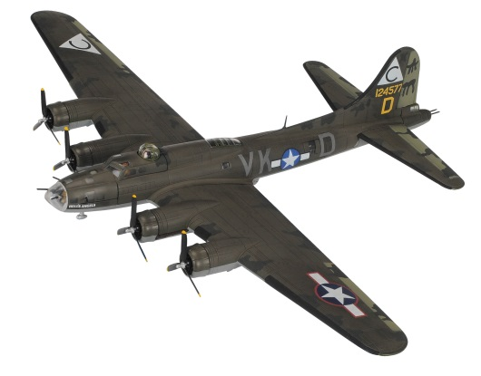
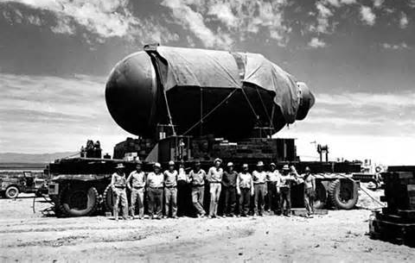
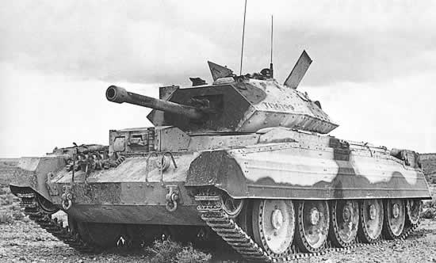
Manufacturing History Starting with World War II
American Mobilization of the entire workforce
Rosie the Riveter
Higgins Industries grew from a small business to providing 8,865 of the Navy’s 14,072 vessels in 1943.
The average Ford car had 15,000 parts and the B-24 Liberator long-range bomber had 1,550,000 parts. One B-24 off the line at Ford Motor Company ‘s Willow Run plant every 63 minutes.
The Manhattan Project began with a $6,000 budget and by the end of the war employed 130,000 workers and had spent $2.2 billion.
The “Greatest Generation” Delivered

Slide 4
Who Were the Best Manufacturers in 1947?
Wrong question.
Who were the only significant manufacturers in 1947?
Every other country’s manufacturing facilities had been destroyed.
Americans manufactured products and shipped them all over the world. For twenty years, we had no competition.
We thought we were fabulous manufacturers.

Slide 5
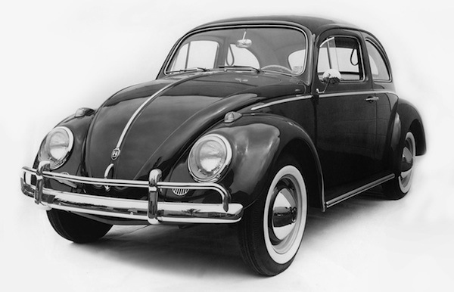
American Manufacturing Reality
Our arrogance closed our eyes to the emergence of manufacturing excellence coming from Japan and Germany.
U. S. Management and Labor fought constantly.
We laughed at the idea in the 60’s and 70’s about the new cars from Japan and Germany

Slide 6
Japanese Share of U.S. Auto Market
American Auto Makers
Japanese Auto Makers

Slide 7
Decisions, Decisions….
If you’re a talented student thinking about your future, is manufacturing top of mind?
If you’re the parent of a talented student, are you advising them to go into manufacturing?
If you’re the high school guidance counselor, are you advising any of your talented kids to go into manufacturing?
Combine this with the American mantra of “If you want to be successful, you have to go to a four year college.”
The answer to all three questions is a resounding NO!

Slide 8
So What?
America can’t have a manufacturing revival without people to make it happen – all the people.
Everyone in a manufacturing facility has to contribute.

Slide 9
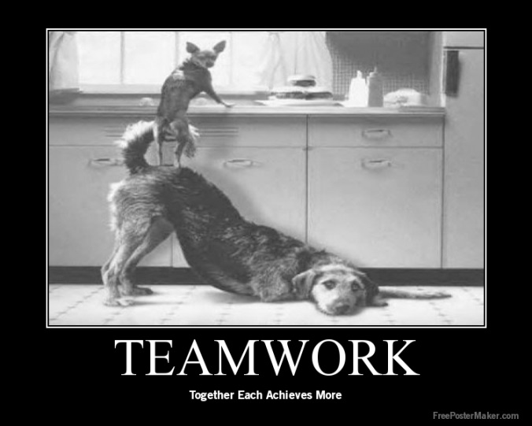
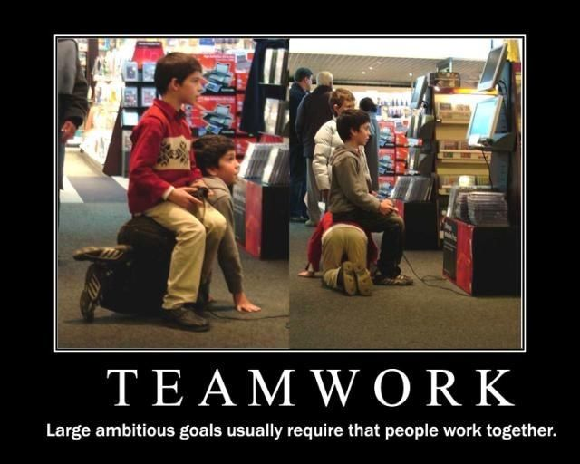
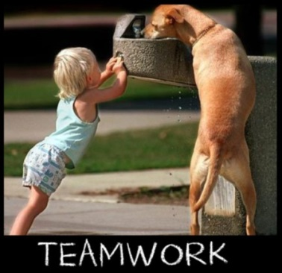
Soft Skills Essential
Teamwork
Problem solving
Attitude
The sum of the individual team members capabilities = the strength of the team.
What’s the strength of our human capital to join today’s team?

Slide 10
The PISA scores show the US is outscored by key economic competitors
23rd in Reading Literacy | 34th in Mathematics Literacy | 27th in Science Literacy
Shanghai, Hong Kong, Singapore, Japan, Republic of Korea, Finland, Ireland, Chinese Taipei, Canada, Poland, Estonia, Liechtenstein, New Zealand, Australia, Netherlands, Belgium, Switzerland, Macao-China, Germany, Vietnam*, France*, Norway*, United Kingdom* | Shanghai, Singapore, Hong Kong, Chinese Taipei, Republic of Korea, Japan, Liechtenstein, Switzerland, Netherlands, Estonia, Finland, Canada, Poland, Belgium, Germany, Vietnam, Austria, Australia, Ireland, Slovenia, Denmark, New Zealand, Czech Republic, France, United Kingdom, Iceland, Latvia, Luxembourg, Norway*, Portugal*, Italy*, Spain*, Russian Federation*, Slovak Republic* | Shanghai, Hong Kong, Singapore, Japan, Finland, Estonia, Republic of Korea, Vietnam, Poland, Canada, Liechtenstein, Germany, Chinese Taipei, Netherlands, Ireland, Australia, Macao-China, New Zealand, Switzerland, Slovenia, United Kingdom, Czech Republic, Austria*, Belgium*, Latvia*, France*, Denmark*
* Marks a score difference that is not statistically significant

Slide 11
ETS Study Con’t
How do the average scores of U.S. millennials compare with those in other participating countries?
Literacy – Only Spain and Italy had lower scores.
Numeracy – US tied for last with Spain and Italy
PS-TRE – US tied for last along with Slovak Republic, Ireland and Poland

Slide 12
Manufacturer’s Challenge #1
Changing the perception of manufacturing. No longer dirty, dark and dangerous.
Manufacturing today is sophisticated and high tech.
Manufacturers need to engage the academic community differently than we have historically.
For talented young adults, this is an opportunity of a lifetime.

Slide 13
Manufacturer’s Challenge #2
Finding young adults:
With brains and a decent education
Who are drug free
Who have a desire to work as part of a team
Who are not entitled

Slide 14
Manufacturers and Educators Must Join Together
We need to challenge educators to think differently about how to educate kids so they’re work or college ready when they graduate high school.
Approximately 25% of the $1.2 Trillion in college debt is remedial education to get students ready to start college.
The AMT model is outstanding and will serve as an example for other industries.
Ford’s Next Generation Learning is another “mold-breaking” model with great success.
What are some of the potential obstacles of manufacturers working effectively with educators?

Slide 15
Summary
It took 30 to 40 years to dig this hole. It’s going to take awhile to recover.
From a manufacturer’s perspective, the education model has to evolve to deliver graduates who can quickly add value to the organization and later become the next generation of manufacturing leaders.
The soft skills are essential.
Educators and manufacturers need to work together as partners recognizing we have different skill sets.
Manufacturing will be an extraordinary opportunity over the next 30 or 40 years.
People are beginning to get it.

